Slide 1
NCDC PROGRAMMES

Slide 2
Antimicrobial Resistance Containment
Antimicrobial resistance is a serious public health threat
Contributory factors:
  Inappropriate use (overuse, underuse and misuse) of antimicrobials in clinical medicine, use of antibiotics as growth promoters in animals
  Inadequately regulated use of antimicrobials
  Poor infection prevention and control in health care settings.
  Lack of hygiene and poor sanitation
  Underdeveloped antibiotic stewardship and Infection prevention & control programmes in health care settings
  Use /availability of poor quality Antibiotics
  Lack of development of new antibiotics
  Lack of inter-sectoral approach

Slide 3
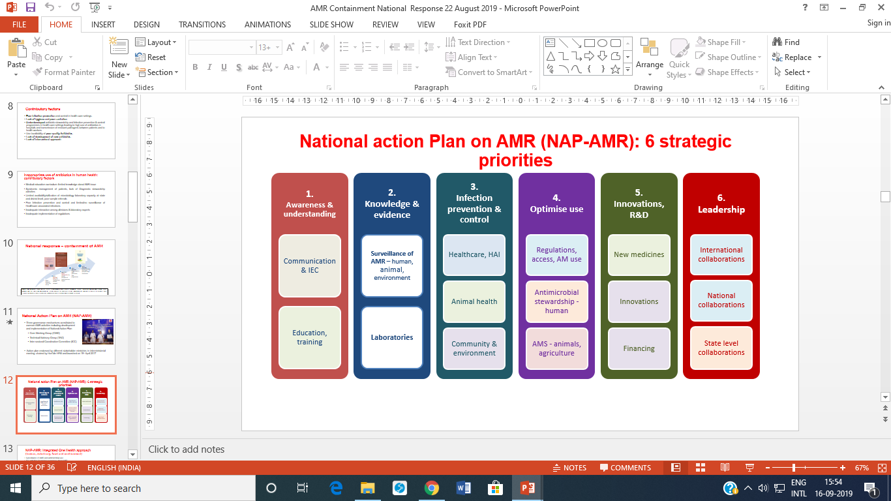
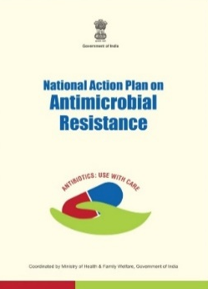
Country response
2010 National Task Force set up
2011 National Policy for Containment of AMR adopted
Sept 2011 Jaipur Declaration by Health Ministers of South-East Asia Region
2012 National Programme on AMR (pilot basis, now programme)
2017 National action Plan on AMR (NAP-AMR) & Delhi Declaration

Slide 4
State action plan for containment of AMR
States sensitised at National consultation in August 2017
Letters sent from Sec (H) in June 2018,
  Guidance document for developing State action plan for containment of AMR
  Copy of NAP-AMR
Technical consultation held on Jan 9th 2019 for developing state action plans on AMR along with patient safety, climate change
Letter sent from MoHFW to states in May 2019 to:
  Identify dedicated state nodal officer for AMR containment
  Establish AMR cell
States to develop SAP for AMR involving Stakeholders
from various departments

Slide 5
Current Status
AMR nodal officer identified: (9) Andhra Pradesh, Assam, Delhi, Kerala, Madhya Pradesh, Punjab, Sikkim, Tamil Nadu& Uttarakhand
Development of state action plan
    Initiated : sensitization done – Karnataka, Manipur, Chhattisgarh, Assam & Sikkim
    Drafted : Delhi
    Launched : Kerala & Madhya Pradesh

Slide 6
Way forward
Next steps for the states
Mapping of AMR stakeholders in the State
Compile the background document – AMR and its Containment in the State
Organize a state workshop to develop state action plan for AMR containment
Establish governance mechanisms for AMR containment in the state
Implementation of state action plan
Stakeholders departments at the state level
State government departments
  Health-public health, medical education, food safety
  Agriculture, animal husbandry, dairying & fisheries
  Environment, Forests & Climate change, state pollution control board.
  Department of Pharmaceuticals/drugs (state dug controller)
  Science ad technology
  Drinking water and sanitation
  Consumer affairs, food & public distribution, and food processing
  Human resource development, medical education, AYUSH, finance and information and broadcasting
Administrators and senior experts at medical colleges & hospitals, medical research centres, nursing, dental, veterinary, agriculture, environment and science colleges/research institutes
Office bearers from professional councils and associations in the state
Key NGOs working on AMR
Manufacturers of diagnostics, pharmaceuticals

Slide 7
National Programme for Climate Change & Human Health
Expectations from states and UTs
Organizational Structure for Climate Change: Form and Notify the at the State and District Level – State Nodal Officer, Environmental Health Cell, State Task Force, Governing Body. The template of organizational structure has been shared with the State Nodal Officers.
Propose Consultant(s) for Climate Change in the Supplementary PIP 2019-20. The states have to initiate Consultant recruitment at the earliest. ( 02 for Large 21 states and 01 for remaining states/UTs )
Preparation of State Action Plan for Climate Change and Human Health preferably by 15th Nov, 2019. - A draft Template shared with the states by the program division.
Initiate Acute Respiratory Illness Surveillance in the most polluted cities of the state with AQI monitoring.

Slide 8
National Programme for Climate Change & Human Health
OBJECTIVES
Identify and prioritize climate sensitive illnesses in each state
Develop appropriate illness specific HAP in coordination with COEs
Ensure adequate preparedness including capacity building of health systems and inter-sectoral coordination (IMD)
Initiate Acute Respiratory Illness Surveillance in the most polluted cities of the states along with AQI monitoring.
Develop IEC, Community involvement strategies and health facilities preparedness

Slide 9
Communications with the states
 | ORGANISATIONAL STRUCTURE | SUPPLE PIP | HEAT related illnesses | ARI sentinel Surveillance | Misc: CRHS, GCF etc
Secretary (Health) | To Chief Secretary: 27th Mar ‘2018 To Chief Secretary: 18th Mar’ 2018 |  | To Chief Secretary: 2nd Apr’2019
Joint Secretary (LA) | To PS (H): 23rd Jan’ 2017; 2nd Apr’ 2018 28th Jun’ 2018; 27th Jul’ 2018; 12th Apr’2019; 21st May’ 2019; 11th Jul’ ,2019 To MD-NHM 2nd May’ 2019 To DHS: 20th Jan’ 2017; 9th Nov’2018 | To PS (H): 12th Apr’ 2019 2nd May’ 2019 To MD-NHM: 11th Jul’ 2019 | To PS (H): 15th Apr’ 2019 | To PS (H): 27th Jul’ 2018; 1st Oct’ 2018; 16thOct’,2018 30thOct’,2018 9th Nov’ 2018 | To PS (H): 2nd May’ 2019
Director (NCDC) | To PS (H): 26th Mar’ 2019 To DHS: 6thSep’ 2018; 18th Jul’ 2019 |  | To PS (H): 28thFeb’ 2019 To DHS : 23rd Apr’ 2018 20th Jun’ 2018 | To PS (H): 26th Mar’ 2019 21st May’’ 2019

Slide 10
Communication with the states contd
Video Conference :
  13th May, 2019 by Joint Secretary Shri Lav Agarwal
  2nd Week August 2019
  Meetings/ Workshops
  Regional Consultations with Nodal Officers at state level
  National Sensitisation workshop at New Delhi on 3rd to 5th Oct, 2018.
  National Consultation at New Delhi: 9th Jan, 2019

Slide 11
Status Note
State Program Officers: 34 out of 37 * (all except J&K, Ladakh and Lakshwadeep Islands)
Environmental Health Cell : 22 States
Formation of Task Force : 22 States
Formation of Governing Body : 15 States
Submission of Supplementary PIP 2019-20 - 05 States.
Consultant Recruitment
  The states have been asked to recruit consultants (02 for large and 01 for small states) for the program.
  The ToR’s for Consultant Recruitment have been shared with the states vide Letter no. 67/NCDC/CEOHCCH/2018-19/EPC dated 11th July,2019.

Slide 12
Priority Zoonosis &National Programmes
  Priority Zoonosis
  Rabies
  Leptospirosis
  KFD
  Antharx
  Scrub Typhus
  Brucellosis
  Nipah
  CCHF
National Programs ( Initiated in 12 th FYP )
1. National Rabies Control Program
2. Program for Prevention and control of Leptospirosis

Slide 13
State level components under National Programmes
Sr. No | National Programmes | State level components
1 | National Rabies Control Program ( All states & UTs ) | Capacity Building Promote utilization of cost affective Intra-dermal rabies vaccines for Rabies Post Exposure Prophylaxis. Strengthen rabies diagnostics Strengthening Surveillance of animal bites and rabies cases Information, Education & Communication Intersectional coordination
2 | Program for Prevention and control of Leptospirosis Programme States: Maharashtra,Gujarat Karnataka,Tamil Nadu Kerala,Andaman & Nicobar | Ensuring uninterrupted supply of drugs for chemoprophylaxis and treatment Training of medical & paramedical professionals Strengthening of laboratory diagnostic facilities Improvement of patient management facilities IEC activity Sensitization and joint activities with animal husbandry and agriculture personnel

Slide 14
Issues
National Rabies Control Program: State are requested -
To propose supplementary PIP for FY 2019-20. Communications sent from AS & MD NHM to all Pr. Secretary (H) and
State MDNHM with prescribed FMR Codes.
  States with approved budget in ROP: Assam, Jharkhand, Punjab, Delhi, Sikkim, Pondicherry (6)
  States which proposed budget in Supplementary PIP So far: Nagaland, Goa, Gujarat, Kerala, Mizoram (5)
  State to nominate District level Nodal Officers (Bihar, Delhi, Himachal Pradesh, Manipur, Punjab, Sikkim Maharashtra already nominated DNOs)
To share their training plans (communication from Director NCDC).
States to address shortage of Anti rabies Vaccine and follow the advisory as per guidance note (issued form JS, Shri Lav Agarwal) to the states. States to report shortage of Anti Rabies Vaccine and serum if any to the programme division (as per requirement for HFM Central Dashboard)
Reporting of Cases of animal bites, deaths due to rabies (as per case definition)
To map and list Govt ID Hospital and tertiary care institutes with Rabies in patient facilities to strengthen Surveillance and case reporting of Rabies
States to map and identify potential Lab. For Strengthening diagnosis of Rabies through regional workshops under NRCP and Regional coordinators under ISC programme
Advocacy for “One Health Approach” for Rabies control though state and District Zoonosis Committees

Slide 15
Issues
Program for Prevention and Control of Leptospirosis
Programme states to expedite the expenditure of funds allocated under the programme ( Maharashtra , Karnataka & Tamilnadu )
Advisory sent to the States to prepare action paln to respond to the Leptospirosis Outbreaks . A check list was provided to the affected states through email.
States to put up request for funds for Trainings, Diagnostics kits and Reagents, IEC, Surveillance and monitoring in State PIP
( Proposal submitted to NHM- Under consideration)

Slide 16
Communication sent to States under the NRCP via Emails and Letters- 17 Sept-2019
 | Program Component | From | To | Subject | Date | Type of communication sent
1 | PIP | Additional Secretary & Mission Director | Mission Director | supplementary PIP for FY 2019-20 | 24-May-19 | By email and DO letter
2 | Surveillance | Director | DHS | Nomination of DNO | 14-Dec-18 | By email and DO letter
3 |  | Director | DHS, Jammu | Rabies mortality data and status of PEP implementation | 27-Nov-19 | By email and DO letter
4 |  | Joint Secretary | Principal Secretary | Guidance note for overcoming ARV shortage | 5-Sep-19 | By email and DO letter
5 |  | Joint Secretary | Principal Secretary | ARV- ARS Status and vaccine procurement mechanism | 10-Apr-19 | By email and DO letter
6 | Surveillance and Training | Deputy Director | SNO | Case Definition, Reporting Formats for Rabies, Central Dashboard | 17-Jun-20 | By email
7 | Training Plan | Director | DHS | State and district level training plans for capacity building medical officers and health workers | 10-May-18 | By email and DO letter
8 |  | Deputy Director | SNO | Information of Infectious Diseases Hospitals and Tertiary Care Institutes having in-patient facilities for rabies case management (Government medical colleges, etc) | 9-Sep-21 | By email
9 | General | Deputy Director | DHS | Observance of “World Rabies Day on 28th September 2019 | 4-Sep-19 | By email and letter

Slide 17
Communication sent to States under the PPCL and ISCP via Emails and Letters
 | Program Component | From | To | Subject | Date | Type of communication sent
1 | Surveillance | Joint Secretary | Principal Secretary | Advisory, Preparatory check list and Guidelines for Leptospirosis | 15-Jun-19 | By email and DO letter
2 | Training Plan | Director | DHS, Animal Husbandry Department | Collaboration with the Regional Coordinator identified under ISCP | 29-Jul-19 | By email and DO letter

Slide 18
Establishment of New NCDC Branches in States
State – identification/finalization of land
  Pending (Tamil Nadu, WB, UK, Assam, Goa, Karnataka, Maharashtra, Mizoram, A&N, Chhattisgarh, Telangana, Meghalaya, Orissa, Raj., Haryana, Sikkim, Punjab)
Signing of MoU with State/CPWD – Jharkhand, Manipur, Kerala, MP, Bihar, Nagaland & UP
Transfer of land – Lease deed/land registered – Jharkhand, Manipur, Kerala, Bihar, Nagaland & UP

Slide 19
Situation of Seasonal Influenza A (H1N1)
Months | 2014 |  | 2015 |  | 2016 |  | 2017 |  | 2018 |  | 2019*
 | C | D | C | D | C | D | C | D | C | D | C | D
January | 23 | 4 | 1864 | 169 | 460 | 76 | 680 | 25 | 799 | 70 | 5821 | 219
February | 52 | 7 | 18108 | 906 | 648 | 116 | 2482 | 53 | 488 | 58 | 11004 | 298
March | 77 | 13 | 14268 | 1009 | 261 | 39 | 3355 | 114 | 297 | 32 | 6791 | 273
April | 85 | 27 | 1519 | 161 | 40 | 8 | 1861 | 130 | 94 | 18 | 1637 | 135
May | 122 | 31 | 306 | 43 | 15 | 4 | 1689 | 157 | 45 | 12 | 716 | 122
June | 141 | 24 | 223 | 37 | 10 | 2 | 1538 | 91 | 11 | 0 | 395 | 41
July | 79 | 21 | 517 | 29 | 44 | 2 | 3771 | 187 | 28 | 2 | 604 | 23
August | 78 | 24 | 1795 | 105 | 50 | 6 | 12474 | 614 | 255 | 30 | 537 | 26
September | 97 | 31 | 1980 | 221 | 73 | 3 | 8571 | 594 | 2573 | 145 | 167 | 9
October | 37 | 13 | 1340 | 183 | 52 | 1 | 1483 | 174 | 5150 | 390
November | 40 | 9 | 404 | 81 | 21 | 2 | 342 | 56 | 3200 | 213
December | 106 | 14 | 268 | 46 | 112 | 6 | 565 | 75 | 2326 | 158
Cumulative | 937 | 218 (23.26) | 42592 | 2990 (7.02) | 1786 | 265 (14.83) | 38811 | 2270 (5.84) | 15266 | 1128 (7.38) | 27672 | 1146 (4.13)
Abbreviations: C= Cases, D= Deaths; *Reported till 15.09.2019 (Case Fatality Rate of severe cases)

Slide 20
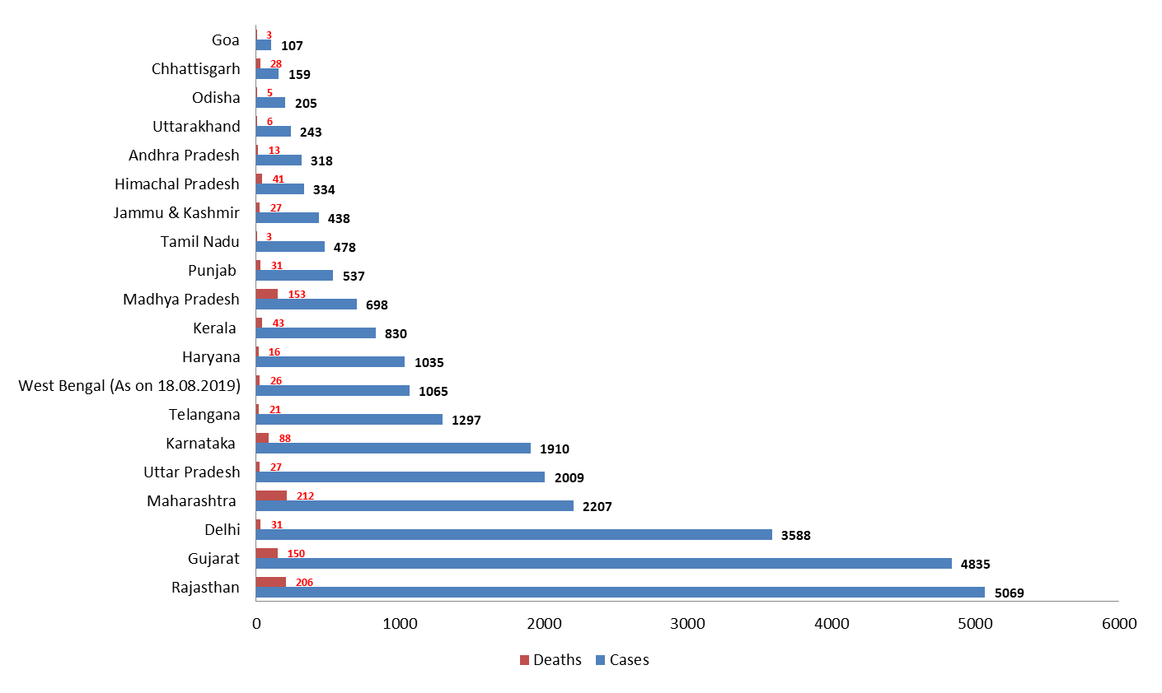
Status of Seasonal Influenza A (H1N1) in Major affected States in 2019

Slide 21
Recommended Drug for seasonal Influenza
Oseltamivir is the drug recommended by WHO. Oseltamivir was also made available under Schedule H1 by Govt. of India so that the drugs are readily available to the needed.
All the States have been advised to complete the procurement of required logistics for managing seasonal influenza A (H1N1) from State budget. However, during crisis in States, Govt. of India is supplying logistics (drugs, PPE kits, N-95 face masks).
Issuance of advisory and training material. Last advisory issued by Director NCDC on 16.08.2019 to all States/UTs.
Support in outbreak response through deputation of Centre Team to the states of Rajasthan, Gujarat , Punjab and Uttarakhand in 2019
Training of SSOs, State Epidemiologists, Clinicians etc.

Slide 22
Thank you

