Slide 1
Ministry of Health & Family Welfare
National Tobacco Control Programme (NTCP)
Presentation for First Quarterly Review Meeting
19th - 20th September, 2019

Slide 2
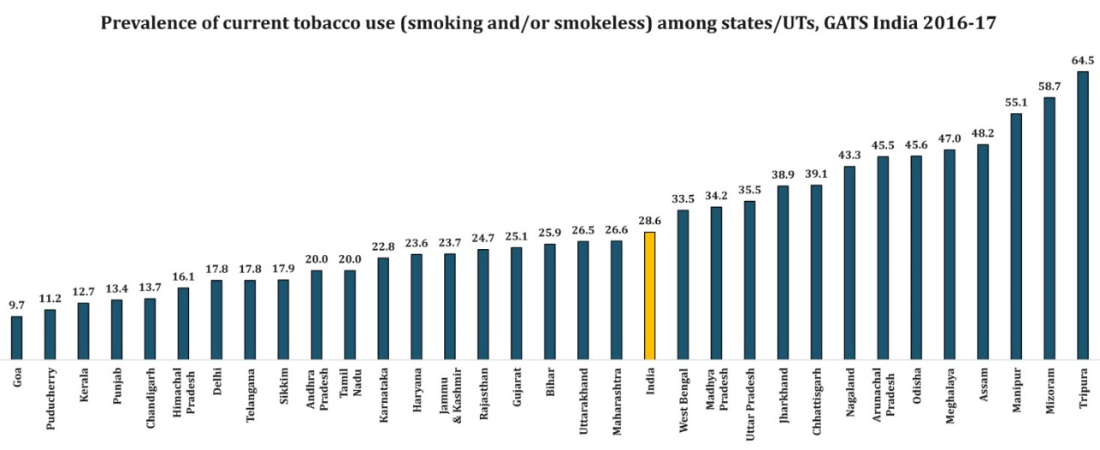
Need of an hour…. Action Plan
The National Health Policy 2017 targets- relative reduction in prevalence of current tobacco use by 15% by 2020 and 30% by 2025’
To achieve these targets – States/UT need to prioritize the activities under NTCP as per prevalence of tobacco use in their respective State/UT.
Prevalence of tobacco use –State-wise (GATS-2 data)

Slide 3
Gaps in Enforcement of Tobacco Control laws
Violations reported for Section 5 and 7 of COTPA are very less in numbers
Section 5: Direct/indirect advertisement of tobacco products including sponsorship and promotion
Section 7: Mandatory display of specified health warnings on tobacco products packages [85% coverage- both sides].
Action required:
Surprise visits to the shops selling tobacco products by the enforcement squads for compliance of Section 5 and 7.
If any violations are observed for Section 5 and 7, action to be taken under Section 20 of the COTPA, 2003 as per the procedure laid in section 12 and 13 of the Act.

Slide 4
Tobacco Free Educational Institutions Guidelines
Objective is to provide a fresh momentum to implementation of tobacco control initiatives among adolescents and young adults.
All educational institution, including schools at all levels, colleges for higher or professional education and universities, both in public and private sector.
Self Evaluation Score Card to enable educational institutions to develop a healthy and tobacco free environment and also get certified as tobacco free if the assessment score is more than 90%.

Slide 5
Tobacco Free Educational Institutions Guidelines
More awareness about harmful effects and long-term health impact of tobacco use amongst the students, teachers, workers and officials in educational institutions.
Awareness about various avenues available for tobacco cessation
Better implementation of legal provisions regarding sale and use of tobacco products, especially those related to educational institutions, public places, statutory warnings and minors.
Action required:
Target to make all public educational institutions tobacco free by 31/03/2020.

Slide 6
Convergence
Start TCCs in –
All Medical and Dental Colleges
All District Hospitals
NPCDCS – NCD Clinics
NOHP – Dental Clinics
RNTCP – Counseling for TB patients
Integrate quit-line services with health helpline.
Funds for training may be used from NTCP or from respective other Programme.

Slide 7
Quarterly Reporting
Quarterly Reports are one of the vital tools to gauge the activities of States/UTs.
It has been observed that;
Some States have submitted their reports on intermittent basis
Some of the States/UTs have not submitted reports for the last FY.
Action required:
To submit the pending Quarterly Reports
To submit the Quarterly Reports regularly (end of each quarter)
Online Reporting: submit reports online from FY 2019-20 onwards.

Slide 8
Recent Initiatives
ToFEI guidelines
ENDS Ordinance
Tobacco testing laboratories notified.
National workshop for law enforcers – October 14th.
GYTS

Slide 9
Features of the ENDS Ordinance
Prohibits production, manufacture, import, export, transport, sale, distribution, storage and advertisement of Electronic-Cigarettes.
Including online sale and advertisement
Punishment: imprisonment upto 1 year and/or fine of Rs. 1 lakh for first offence. 3 year and/or fine of Rs. 5 lakh for subsequent offence.
Made a cognizable offence (except storage, which is a non-cognizable offence).
Sub-Inspector of Police – Authorized Officer
Other Officers can also be authorized by Central\State Governments

Slide 10
Thank you…..

