Slide 1
National AIDS Control Programme
First Quarterly Review Meeting
19th and 20th September 2019
Alok Saxena, Joint Secretary
National AIDS Control Organisation Ministry of Health & FW Government of India

Slide 2
Outline
National AIDS Control Programme at a glance
Agenda Items
Vision document
Fast Track Targets (90-90-90)
The HIV and AIDS (Prevention and Control) Act, 2017
Elimination of Mother to Child Transmission (EMTCT) of HIV
Establishment of Anti-Retroviral Therapy (ART) centres in all Medical College
Improving Voluntary Blood Donation (VBD)

Slide 3
National AIDS Control Programme at a glance

Slide 4
National AIDS Control Programme: Highlights
Fully funded “Central Sector Scheme”
Initiated in 1992
Currently NACP-IV (Extension) 2017-20 under implementation
One of the world’s largest and most comprehensive HIV/AIDS programmes for key populations and PLHIV
Around 10 million of most at risk population covered through 1404 targeted interventions
More than 4.5 crore HIV tests in year through 31,377 HIV counselling and testing facilities
14.36 lakh HIV patients on life long free Anti-Retroviral Therapy (ART) (primarily through central government funding at 1,654 ART and Link ART Centers)

Slide 5
National AIDS Control Programme: Achievements
Halted and reversed the HIV/AIDS Epidemic
80% reduction in new HIV infections since peak in 1995 (Global average of 47%)
70% reduction in AIDS related deaths since its peak in 2005 (Global average of 51%)
From a virtual death sentence to a chronic manageable disease

Slide 6
National AIDS Control Programme: Evolution & Progress
NACP I (1992-1999)
Centralized approach
Awareness and Blood Safety
NACP III (2007-2012)
District Focus
Massive scale up of services with quality assurance mechanisms
Universalization of testing of HIV among pregnant women
NACP IV (2012-17)
Consolidate gains
Focus on emerging vulnerabilities,
Balance prevention with growing treatment needs,
Integrate & Mainstream
NACP II (1999-2006)
Decentralization to states
Prevention, Counseling and Testing
Launch of treatment services(2004)
NACP-IV Extension (2017-20)
Committed to make concrete progress towards “End of AIDS by 2030”
Test and Treat; Mission Sampark
Viral Load Monitoring
HIV/AIDS Act
Prison interventions

Slide 7
Goals and Targets
2030
End of AIDS epidemic
as Public Health threat
SDG Goal 3, Target 3.3
2020
Reduce new HIV infections by 75% (Baseline 2010)
Achieve treatment targets of 90-90-90
Eliminate Mother to Child Transmission of HIV
Eliminate HIV-related stigma and discrimination
Fast Track Targets
90-90-90 By 2020
90% of all people living with HIV will know their HIV status
90% of all people with diagnosed HIV infection will receive sustained antiretroviral therapy
90% of all people receiving antiretroviral therapy will have viral suppression

Slide 8
Global and India HIV/AIDS Epidemic Status
HIV Prevalence (%) in different population groups (India)
Indicator | Global (2018) | India (2017)
People living with HIV (All ages) | 3.79 crore | 21.40 lakh
New HIV Infections (All ages) | 17 lakh | 88,000
PLHIV on ART | 2.33 crore | 14.36 lakh*
AIDS-Related Deaths | 7.70 lakh | 69,000
* As on July 2019
Low Prevalence Country (0.22%); Concentrated epidemic
3rd Largest No. of PLHIV in the world
Female: 42% of PLHIV; Children: 3% of PLHIV
Source: HIV Estimations 2017, HIV Sentinel Surveillance 2016-17, NACO

Slide 9
State Wise Adult Prevalence (%) (2017)

Slide 10
State Wise People Living with HIV/AIDS (2017)

Slide 11
Agenda Item 1: Vision document

Slide 12
Agenda Item 1: Vision document (2019-2024)
Goal: Ending AIDS by 2030
Targets
1. 80% reduction in new HIV infections (against baseline of 2010)
2. Ensuring that 95% of those who are HIV positive in the country know their status, 95% of those who know their status are on treatment and 95% of those who are on treatment have durable viral load suppression.
Key performing Indicators (KPI)
Parameter(s) and Unit | Quantified Target
 | 15 August 2022 | 1st year (2019-20) | 2nd year (2020-21) | 3rd year (2021-22) | 4th year (2022-23) | 5th year (2023-24)
Number of HIV tests conducted annually (lakhs) | 668 | 450 | 500 | 668 | 783 | 900
Number of PLHIV on ART cumulative (lakhs) | 18.7* | 13.9* | 15.3* | 18.7* | 19.7* | 20.3*
Number of PLHIV tested for Viral Load cumulative (lakhs) | 13 | 7 | 11 | 13 | 14 | 16
* Including PLHIV taking ART from private sector

Slide 13
Context
SACS are autonomous societies, but function under an Executive Committee Chaired by Principal Secretary, Health/Additional Chief Secretary
Central Sector Scheme, funds routed directly to SACS
State support is required in the form of
Deputation of officers to SACS
Use of health systems for testing and treatment
Warehouses for drugs/ kits
Fast tracking of HIV/AIDS Prevention and control (2017) act
Increasing need for resources from States is envisaged
HIV Screening Kits at Primary Health Center Level
Human Resources at ART Center
Opportunistic infections management
Social Protection Schemes

Slide 14
Agenda Item 2: Fast Track Targets (90-90-90)

Slide 15
Agenda Item 2: Fast Track Targets (90-90-90): National Scenario vis-à-vis global average
Indicator | Target (2020) | India (2018-19) | Global (2018)
Percent PLHIV aware of their HIV Status | 90% | 79% | 79%
Out of PLHIV who know their HIV status, % PLHIV on ART | 90% | 82% | 78%
Out of PLHIV who are on ART, % PLHIV Virally Suppressed | 90% | 78%* | 86%
* Refers to April-August 2019

Slide 16
Agenda Item 2: Fast Track Targets (90-90-90) State Wise (2018-19)
State | First 90 | Second 90 | Third 90
West Bengal | 34 | 89 | 83
Arunachal Pradesh | 38 | 63 | 82
Jharkhand | 41 | 80 | 75
Haryana | 47 | 72 | 54
Manipur | 50 | 86 | 85
Odisha | 54 | 86 | 79
Telangana | 59 | 91 | 70
Bihar | 59 | 79 | 77
Goa | 59 | 84 | 86
Tripura | 62 | 88 | 68
Uttarakhand | 65 | 79 | 85
Madhya Pradesh | 65 | 77 | 76
Mizoram | 67 | 79 | 86
Assam | 68 | 77 | 78
Kerala | 69 | 96 | 86
State | First 90 | Second 90 | Third 90
Uttar Pradesh | 72 | 82 | 79
Chhattisgarh | 73 | 76 | 80
Nagaland | 77 | 65 | 73
Karnataka | 85 | 83 | 69
Rajasthan | 90 | 87 | 76
Gujarat | 90 | 87 | 80
Sikkim | 94 | 89 | 89
Andhra Pradesh | 94 | 75 | 74
Delhi | >95 | 77 | 81
Meghalaya | >95 | 72 | 82
J&K | >95 | 77 | 79
Punjab | >95 | 83 | 76
Maharashtra | >95 | 84 | 82
Tamil Nadu | >95 | 84 | 78
Himachal Pradesh | >95 | 87 | 69
India | 79 | 82 | 78

Slide 17
Areas of Considerations
New HIV infections:
Timely contracting and release of budget to NGO/CBO Led targeted interventions / Link worker scheme
Multi-sectoral response (Education, WCD, Social justice & empowerment, Labor, etc)
HIV Testing
Testing Enough
Testing Right
Treatment
ICTC-ART Linkage
ART Initiation
ART Retention
ART Adherence
Quarterly reviewed with SACS

Slide 18
Agenda Item 3: The HIV and AIDS (Prevention and Control) Act, 2017

Slide 19
The HIV & AIDS (Prevention & Control) Act, 2017 Evolution
10th September
2018
HIV and AIDS (Prevention and Control) Act, 2017 was brought into force
17th September
2018
Central Government Rules (Section 47) were notified after due assent from MoL&J
2019
2019
31st May, 2019
15 states have finalised the state rules
2 states have already appointed the Ombudsman
24 States have held state consultations on HIV and AIDS Act, 2017

Slide 20
The HIV & AIDS (Prevention & Control) Act, 2017
Hailed as the most progressive such legislation in the world
Passed by the Parliament in April 2017; Central Rules notified in September 2018
Address stigma & discrimination
Create an enabling environment for enhancing access to services
Safeguarding rights of PLHIV & those affected by HIV
Provide free diagnostic facilities and ART to PLHIVs.
Promote safe workplace in healthcare settings to prevent occupational exposure
Strengthen system of grievance redressal

Slide 21
State-wise status update on framing of Rules (1)
Status | Name of States
Rules Notified | Punjab , Chhattisgarh
Ombudsman deputed | Himachal Pradesh, Jharkhand
Rules formulated, under approval | Goa, Karnataka, Odisha, Haryana, Rajasthan, Madhya Pradesh, Gujarat, Delhi, Nagaland, Maharashtra
Rules not formulated | Uttar Pradesh, Meghalaya, Bihar, Assam, Arunachal Pradesh Uttarakhand, Andhra Pradesh, Manipur, Mizoram, Sikkim, Tripura, West Bengal, Jammu and Kashmir, Kerala, Telangana Tamil Nadu, Rest of UTs

Slide 22
Agenda Item 4: Elimination of Mother to Child Transmission (EMTCT)

Slide 23
Agenda Item 4: Elimination of Mother to Child Transmission (EMTCT)
One of the 2020 fast-track targets
Antenatal care coverage (at least one visit) of > =95%
Coverage of HIV testing of pregnant women of > =95%
Antiretroviral treatment coverage of HIV-positive pregnant women of > =95%
% pregnant women tested for HIV against estimated pregnancies
Uttar Pradesh, Bihar, Madhya Pradesh Critical to achieve EMTCT
Notes:
15 States district level estimates

Slide 24
Support Required
Single window access to HIV testing along with other antenatal testing (Hb, Sugar, Urine, Hepatitis, Syphilis) – mismatch in no of pregnant women screened for HIV and Syphilis
Whole blood finger prick tests for community-based HIV screening of all pregnant women including village health and nutrition day (VHSND)-
Training ANM/ Asha for HIV screening at Village Health and Nutrition Day and linkage of screened reactive for confirmation of the diagnosis.
Incentivized referral linkages of positive pregnant women to ARTC may be funded by States.

Slide 25
15 Priority States Strategy for Prevention of Parents to Child Transmission (PPTCT)
States | PMTCT need [2017]
Maharashtra | 2,406
Uttar Pradesh | 2,286
Bihar | 2,090
Andhra Pradesh | 1,960
Karnataka | 1,951
Telangana | 1,737
West Bengal | 1,453
Gujarat | 1,297
Tamil Nadu | 1,167
Rajasthan | 959
Madhya Pradesh | 723
Jharkhand | 632
Odisha | 603
Delhi | 533
Haryana | 446
Total [15 states] | 20,243
India total | 22,677
% contribution of 15 states to India total | 89.27
Priority Districts
Intensified interventions
NHM Collaboration

Slide 26
Agenda Item 5: Establishment of Anti-Retroviral Therapy (ART) centres in all Medical College

Slide 27
Agenda Item 5: Establishment of Anti-Retroviral Therapy (ART)
Board of Governors in super-session of Medical Council of India has issued an amended Gazette notification, dated 25th June 2019, wherein establishment of ART center is mandatory for all Medical Colleges, which are functional for more than 4 years
Around 30 Government and 198 private Medical Colleges are functional for more than 4 years and do not have an ART center
For medical college (Government or Private) which do not have an ART center, NACO to provide drugs and Technical support while HR and Infrastructure is supported by Institutes
For medical colleges (Government) where ART center is already functional with NACO support, Medical Colleges may take over the HR and recurring cost component of ART centers in phased manner
For medical colleges (private) where ART center is already functional in PPP mode, it is proposed to continue to same approach

Slide 28
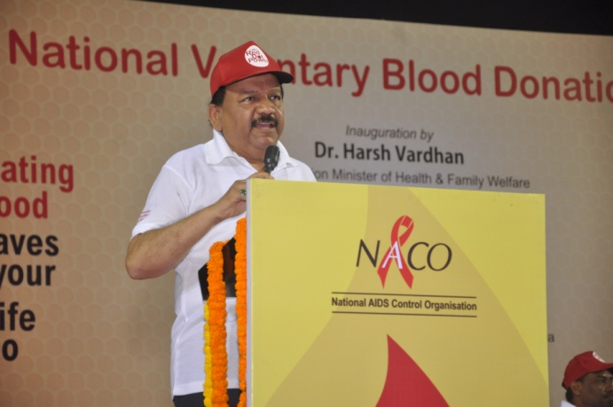
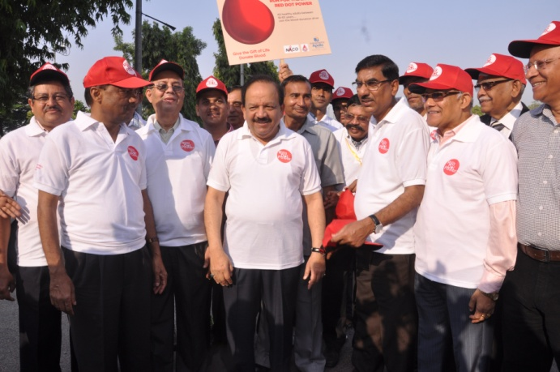
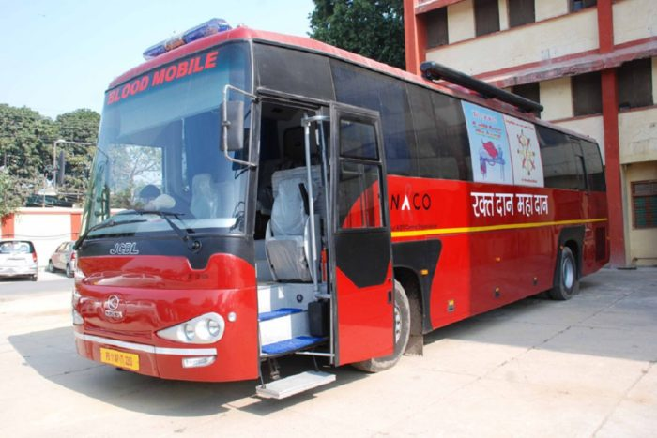
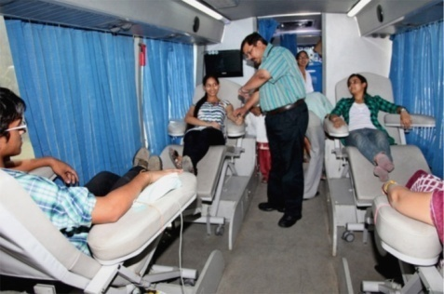
Blood Transfusion Services
Promoting non- remunerated Voluntary Blood Donation; screening for HIV and other Transfusion Transmissible Infection;
Promoting Component separation
Strengthening Quality management systems and Capacity building
Around 12 million blood units collected in 2018-19

Slide 29
Agenda Item 6: Improving Voluntary Blood Donation (VBD)
National Blood Transfusion Council (NBTC) of India promote 100% voluntary blood donation in all blood banks across the country
Revitalizing and Augmenting State Blood Transfusion Council
% Voluntary Blood Donation

Slide 30
Support Required
State Blood Transfusion Council (SBTC) is set up in all State and UT under chairpersonship of Prl. Secretary Health, but not optimally functional.
Director SBTC to be designated
State funds allocated for voluntary blood donation
Setting up of up public sector blood banks in districts without blood banks
All NBTC norms and guidelines to be complied with
Regular meetings of Governing Body of SBTC to be convened (at least two meetings in a year)
Observance of World Blood Donation Day and National Voluntary Blood Donation Day

Slide 31
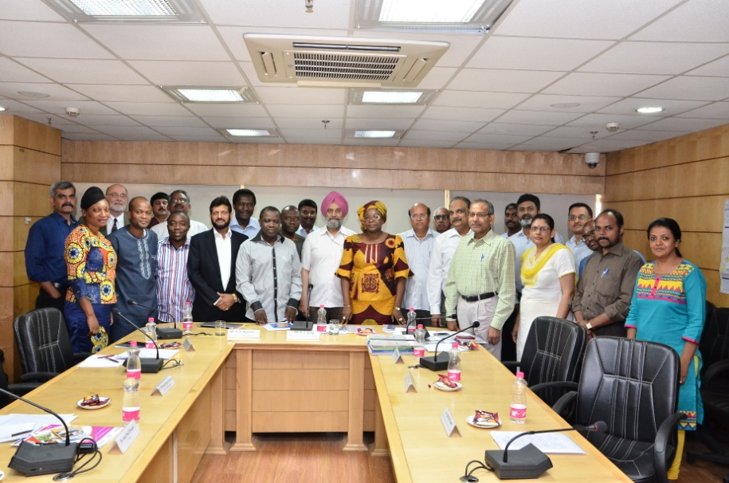
Thank you
2011: Appreciated in UN General Assembly Special Session
2013: India elected the Chair of UNAIDS Board
Wide recognition for supplying ARV medicines for PLHIV across the world
Over 20 International governmental delegations visited India; South to South Collaboration

